Slide 1
An Application of Machine Learning on Predicting Diamond Prices
Xuan Lin

Slide 2
Motivation
Too many relevant characteristics makes it hard for consumers to determine the price
Retailers may have the incentive to exaggerate the importance of certain characteristic to get higher profits
The growth of online sales of diamonds lowers the search cost and makes price comparison more feasible. If we can find an accurate prediction model, there is higher chance for consumers to find a better deal

Slide 3
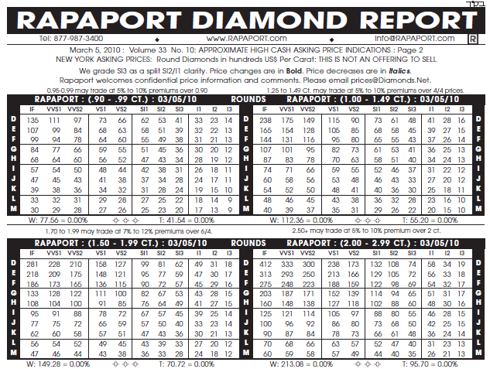
Literature
Rapaport Price List, created by Martin Rapaport in 1978
Currently the diamond industry standard for pricing of diamonds
However, the pricing methodology is not transparent. Conflict of interest is also a concern because Martin is heavily involved in the diamond industry

Slide 4
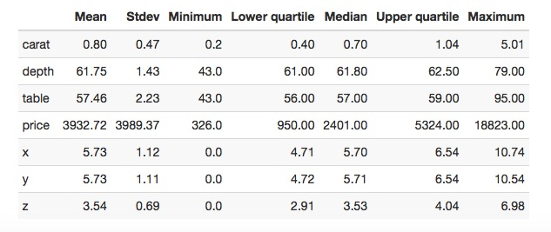
Data Description
53940 observations and 10 variables
Cut, color and clarity are categorical variables

Slide 5
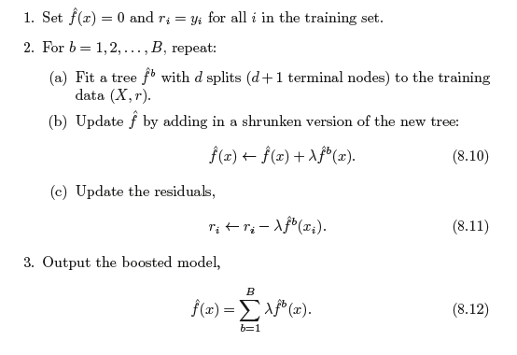
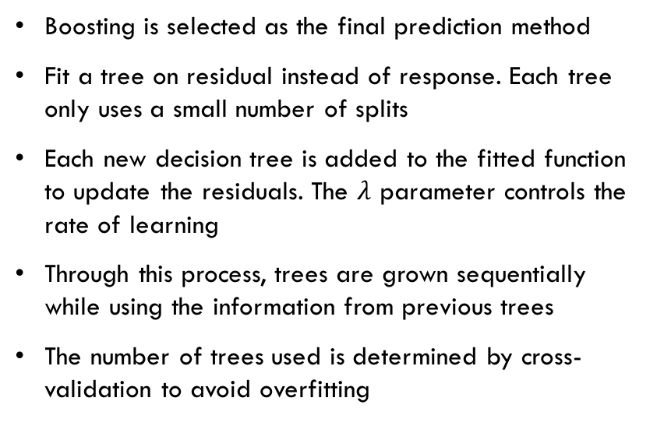
Prediction Model
Boosting is selected as the final prediction method
Fit a tree on residual instead of response. Each tree only uses a small number of splits
Each new decision tree is added to the fitted function to update the residuals. The $λ$ parameter controls the rate of learning
Through this process, trees are grown sequentially while using the information from previous trees
The number of trees used is determined by cross-validation to avoid overfitting

Slide 6
Prediction Results
Strong linear correlation between predicted and actual price suggests high prediction accuracy
Points are evenly scattered around the 45 degree line – no systematic prediction errors

Slide 7
Prediction Results
Diamond size and weight play the most important roles in determining price, while cut quality contributes little to price
However, Blue Nile, the world’s leading diamond retailer, merchandises cut quality as the most important factor

Slide 8
Model Comparison
Boosting generates a smaller error rate compared to other models
Boosting does not have a specified functional form, thereby having a lower bias in prediction
Method | Test MSE
Linear regression | 1276575
Ridge | 1323289
Lasso | 1324159
Boosting | 301174

Slide 9
Comparison to Ordinary Least Square (OLS)
OLS assumes a linear relationship between response and predictors
However, such linearity assumption is questionable in reality
Price increases exponentially with carat
The change in price does not have a clear pattern with clarity

Slide 10
Conclusion
Boosting regression outperforms many parametric models in terms of prediction accuracy
Diamond size-weight is the most important characteristic in predicting prices, while cut quality only has trivial effects

